Slide 1
Elections Chatbot
Team Echo
Harshdeep singh
Sagrika Aggarwal
Kim Shiu Jeffrey Lo

Slide 2
Technologies Used
Scrapper
Python
Web Application
Html
CSS
JavaScript

Slide 3
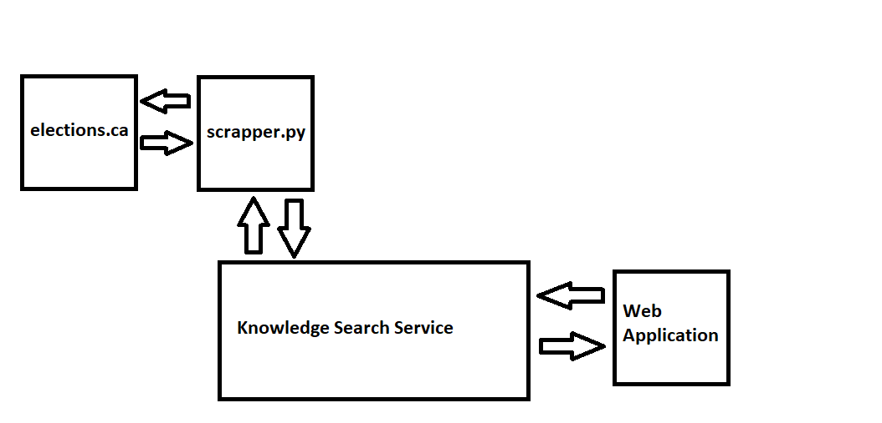
Work Flow

Slide 4
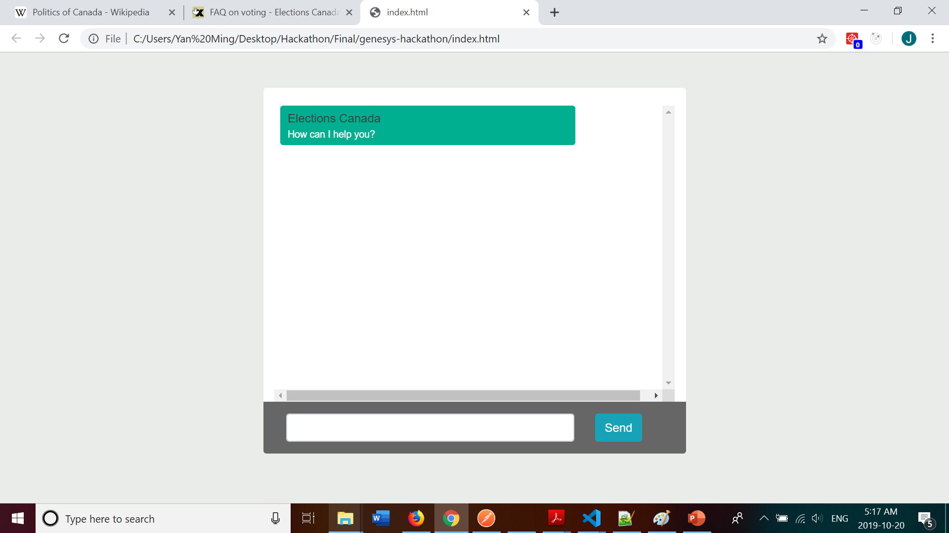
Home Page

Slide 5
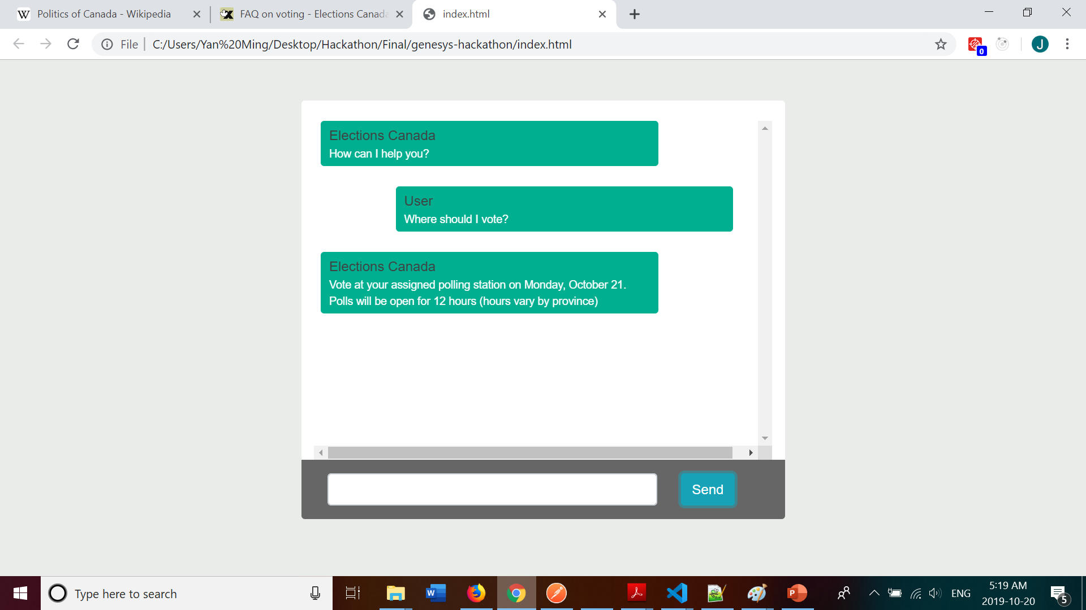
Asks a question

Slide 6
Thank You

